Slide 1



COST OF LIVING ANALYSIS
Deepak Mengal

Slide 2
Project Objective :
The goal is to analyze the cost of living in different cities and countries globally.
Understand major expenses people face worldwide.
Highlight economic diversity and challenges influencing daily life.
Data Source: Using a dataset from Numbeo, an online database providing cost of living understand its structure (columns, data types, etc.)
Major Expenses: Identify key expenses that contribute significantly to the cost of living : Transport, Housing and Education. Explore how these expenses vary across cities and countries. Summarize your findings. Highlight cities or regions with unique cost-of-living profiles.

Slide 3
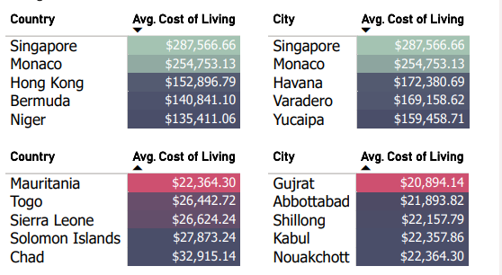

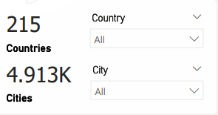
What are the cities and countries with the highest and lowest cost of living?

Slide 4
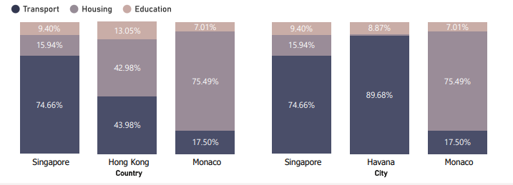
What are the major cost components contributing to the overall cost of living?

Slide 5
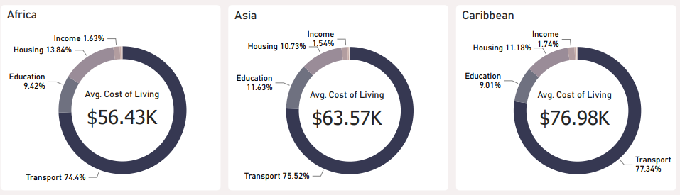
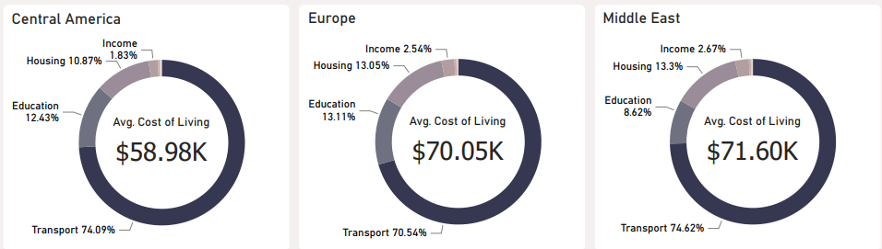
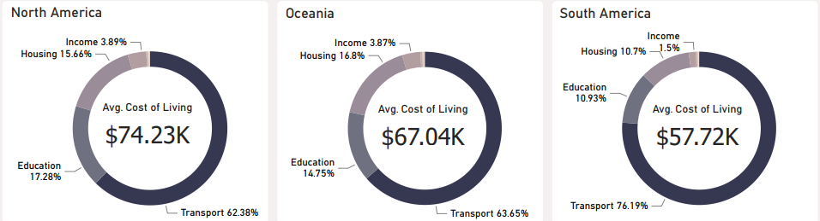
Transportation: This is the largest cost component across most regions. It includes expenses related to public transport, private vehicles, fuel, and associated costs. Housing: The second-largest cost component, particularly significant in North America, Oceania, Europe, and the Middle East. It encompasses rental costs, property prices, and maintenance expenses. Education: A significant contributor, especially in North America, Europe, and Oceania. Education costs include expenses related to private and international schooling. Income: While not a direct expense, income influences purchasing power and overall cost of living. Higher income regions tend to have higher costs across other categories.

Slide 6
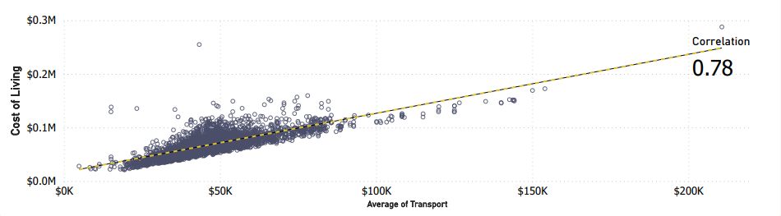
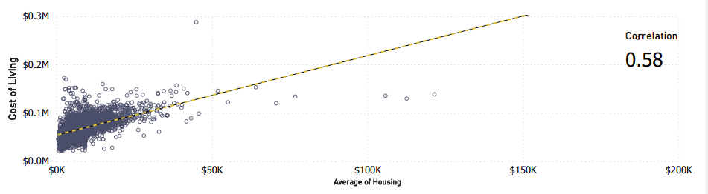
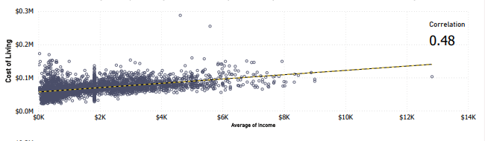
How do factors like average salary, housing costs, and transportation expenses correlate with the cost of living? Transportation Expenses: These have the strongest correlation with the overall cost of living. High transportation costs can significantly impact a city’s affordability. Efficient public transport systems, affordable fuel prices, and well-maintained roads contribute to managing these expenses. Housing Costs: The second-most influential factor. Housing expenses include rent, property prices, and maintenance costs. Cities with high housing costs tend to have a higher overall cost of living. Implementing affordable housing policies and encouraging sustainable housing development can help mitigate this. Average Salary: While individual salaries correlate with the cost of living, it’s essential to consider the combined effect of all factors. A city with high salaries but also high housing and transportation costs may still have an elevated cost of living. Focusing solely on increasing salaries may not be as effective as addressing housing and transportation costs.

Slide 7
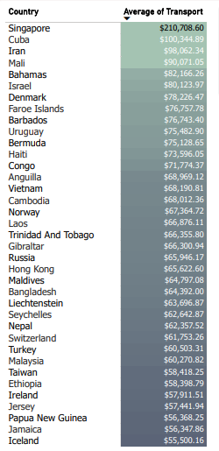
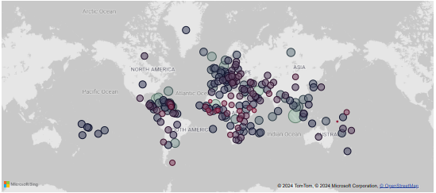

Analysis of average transportation costs across various countries, considering different categories: Average of Transport $47.56K One-way Ticket (Local Transport): This cost reflects the price of a single local transport ticket. Monthly Pass (Regular Price): The average monthly cost for regular public transportation passes. Taxi Start (Normal Tariff): The initial fare for a taxi ride. Taxi 1km (Normal Tariff): The cost per kilometer traveled in a taxi. Taxi 1-hour Waiting (Normal Tariff): The hourly waiting charge for taxi services. Gasoline (1 liter): The average price of one liter of gasoline. Additionally, let’s explore the prices for new cars: Volkswagen Golf 1.4 90 KW Trendline Toyota Corolla Sedan 1.6l 97kW Comfort Now, here are the standout observations: Singapore: With an average transportation cost of $210,708.60, Singapore leads the pack. This high cost is likely driven by expensive new cars and significant transportation-related expenses. Singapore’s policies on car ownership, including high taxes and fees to limit the number of vehicles on the road, contribute to this figure. Cuba: Following closely, Cuba has the second-highest average transportation cost at $100,344.89. Limited vehicle availability, high import taxes, and fuel costs contribute to this expense. Solomon Islands: On the other end of the spectrum, the Solomon Islands have the lowest average transportation cost at $4,827.66. This affordability is attributed to lower fuel costs, reduced reliance on automobiles, and affordable local transportation options. These findings emphasize the significant impact of transportation costs on the overall cost of living, especially in Singapore and Cuba. Strategic economic and policy interventions are necessary: For Singapore: Investing in public transport infrastructure and reducing car ownership costs.

Slide 8
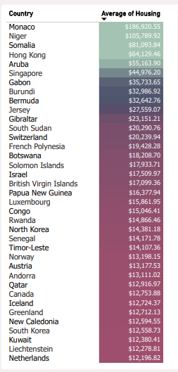
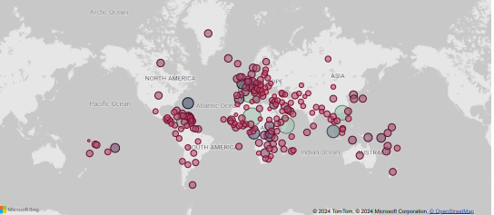
Analysis of housing costs across various countries, considering different factors: Average of Housing $9.12K Apartment (1 bedroom) in City Centre Apartment (1 bedroom) Outside of Centre Apartment (3 bedrooms) in City Centre Apartment (3 bedrooms) Outside of Centre Price per Square Meter to Buy Apartment in City Centre Price per Square Meter to Buy Apartment Outside of Centre Mortgage Interest Rate (20-year fixed-rate) Now, let’s explore the standout observations: Monaco: With an average housing cost of $186,920.55, Monaco stands out. This high cost is likely driven by Monaco’s limited land area, high demand for luxury real estate, and its overall status as a premium residential location. Wealthy individuals from around the world are attracted to Monaco, contributing to its expensive housing market. Tuvalu: On the other end of the spectrum, Tuvalu has the lowest average housing cost at $1,621.48. The affordability in Tuvalu can be attributed to its smaller, less developed real estate market, lower demand, and more affordable construction and land prices.

Slide 9
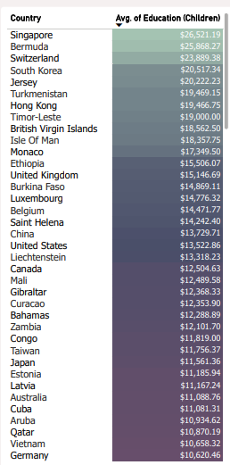
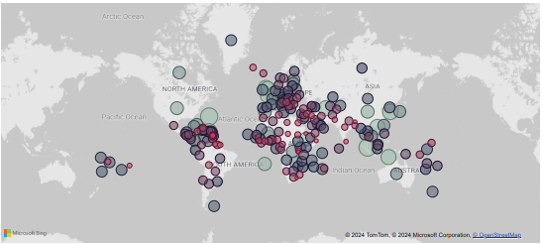
Analysis of education costs across various countries, considering different educational factors: Average.of Education (Children) $9.26K Preschool (or Kindergarten), Full Day, Private, Monthly for 1 Child International Primary School, Yearly for 1 Child Now, let’s delve into the standout observations: Singapore: With an average education cost of $26,521.19, Singapore leads the way. This high cost is primarily driven by the premium placed on private and international education. Factors such as extensive educational services, high demand for quality education, and the presence of expatriates seeking internationally recognized schooling contribute to this expense. Bermuda: Following closely, Bermuda has the second-highest average education cost at $25,868.27. Similar to Singapore, Bermuda emphasizes private and international education, making it an attractive destination for families seeking high-quality schooling. Gambia: On the other end of the spectrum, Gambia has the lowest average education cost at $387.09. The affordability in Gambia can be attributed to its lower overall cost of living, reduced demand for private and international schooling, and differences in economic conditions that influence educational pricing.

Slide 10
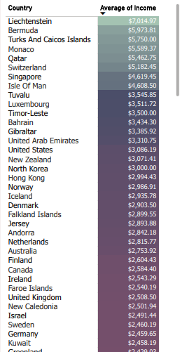
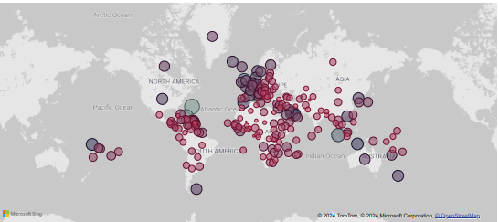
Analysis of average income across various countries, considering the disparities observed: Average of Income $1.82K Liechtenstein: With an average income of $7,014.97, Liechtenstein leads the way. This high income reflects robust economic conditions, a high standard of living, and significant wealth in the region. Liechtenstein’s strong financial sector, low tax rates, and prosperous economy provide ample earning opportunities for its residents. Bermuda: Following closely, Bermuda boasts an average income of $5,973.81. Its economy benefits from being a global financial hub, attracting high-income professionals and businesses. Mali: On the other end of the spectrum, Mali has the lowest average income at $109.58. This stark difference highlights economic challenges and lower living standards in Mali. Issues such as poverty, limited access to education and healthcare, and economic instability contribute to this disparity. These insights reveal substantial variations in income levels worldwide, directly impacting the cost of living and quality of life in different regions. While high average incomes in Liechtenstein and Bermuda contribute to higher living costs, they also provide residents with greater financial stability and access to better services and opportunities. For individuals and businesses considering relocation or investment, these high-income regions may offer attractive opportunities despite the associated higher costs. Conversely, the low average income in Mali underscores the need for policymakers and international organizations to focus on economic development, poverty alleviation, and improving access to essential services. Understanding these income disparities is crucial for developing targeted economic policies and strategies aimed at fostering equitable economic growth and improving living standards across different regions.

Slide 11
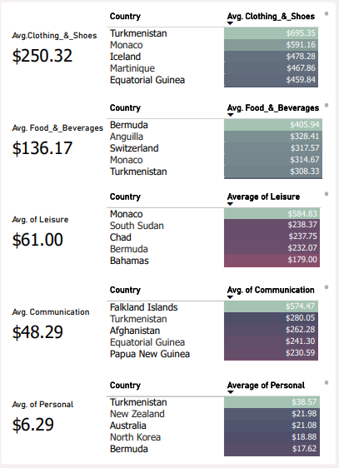
Strategic recommendations for both individuals and organizations based on the analysis of cost of living data: For Individuals: Relocation Planning: Use regional cost data to make informed decisions about where to live. Consider balancing income potential with living expenses. Research the cost of transportation, housing, and education in different regions before making relocation decisions. Budgeting: Adjust budget to account for high-cost components such as transportation, housing, and education. Be aware of regional variations. Career Decisions: When evaluating job opportunities, consider regions with higher income potential. However, weigh this against the cost of living to ensure financial stability. For Organizations: Location Strategy: Optimize office locations and operational bases by considering regions with lower overall costs of living. This can help reduce expenses for the organization. Compensation Packages: Tailor compensation and benefits packages to reflect regional cost differences. Offer higher salaries, housing allowances, or education benefits in high-cost areas. Employee Support: Provide additional support for employees in regions with high living costs. Consider transportation subsidies, housing assistance, and education support. Conclusion: Analyzing cost of living data reveals critical trends and patterns that can guide strategic decisions. Understanding the significant variations in costs across regions empowers individuals to make informed choices about relocation, budgeting, and career opportunities. For organizations, optimizing operational strategies, compensation packages, and employee support programs ensures competitiveness and attractiveness in various economic environments.

